Slide 1
RESEARCH agent
IBM SKILLSBUILD PROJECT
Presented By :
Student Name : SOUGATA SARKAR
College Name : UNIVERSITY OF ENGINEERING & MANAGEMENT KOLKATA
Department : COMPUTER SCIENCE AND TECHNOLOGY

Slide 2
OUTLINE
PROBLEM STATEMENT
TECHNOLOGY USED
WOW FACTOR
END USERS
RESULT
CONCLUSION
GITHUB LINK
FUTURE SCOPE
IBM CERTIFICATIONS

Slide 3
Problem Statement
Current Challenge:
Researchers, students, and professionals struggle with:
Rapidly increasing volume of academic publications.
Difficulty in synthesizing multi-domain information quickly.
Manual literature reviews being time-consuming and inefficient.
Proposed Solution:
An AI-powered Research Agent using NLP + Retrieval-Augmented Generation (RAG), deployed on IBM Cloud with IBM Granite model, to:
Search literature.
Summarize papers.
Organize references.
Suggest hypotheses.
Identify research gaps.

Slide 4
Technology used
IBM Cloud Lite Services
Natural Language Processing (NLP)
Retrieval-Augmented Generation (RAG)
IBM Granite Foundation Model

Slide 5
IBM cloud services used
IBM watsonx.ai Studio
IBM watsonx.ai Runtime
IBM Granite Model
IBM Cloud Object Storage

Slide 6
Wow factors
Semantic Search across research papers, journals, datasets.
Auto-Summarization of papers.
Citation & Reference Analysis to trace influence.
Research Recommendations based on current topics.
Trend Analysis over time for keywords/domains.
Collaboration Mapping for potential co-authors/institutions.

Slide 7
End users
Academic Researchers
Universities & Research Institutes
Industry R&D Teams
Educators

Slide 8
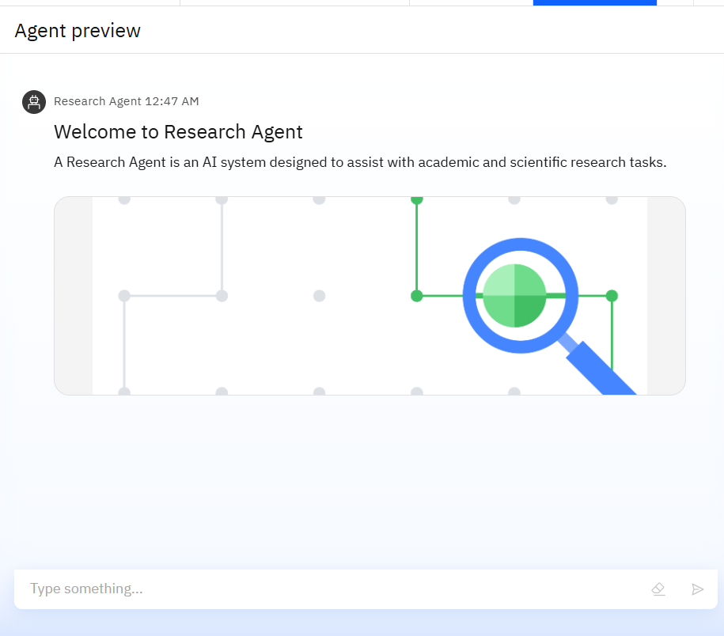
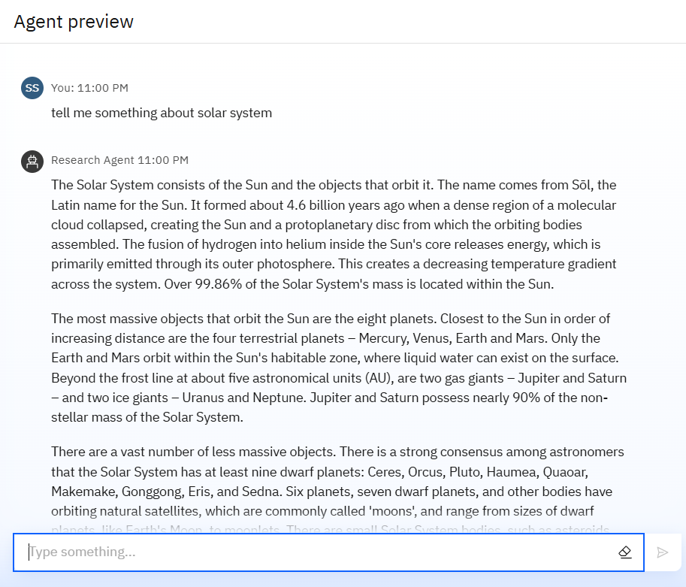
Results

Slide 9
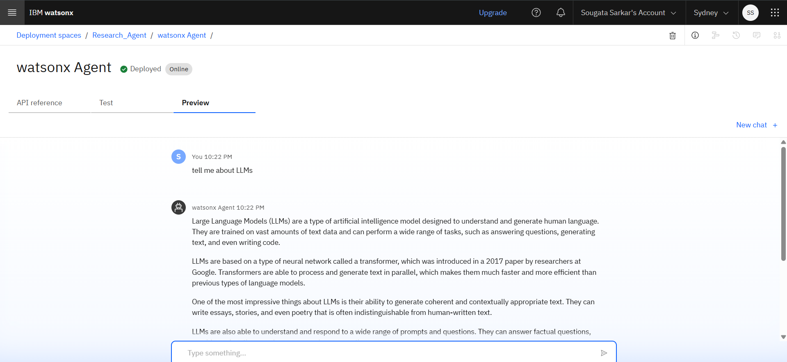
Results

Slide 10
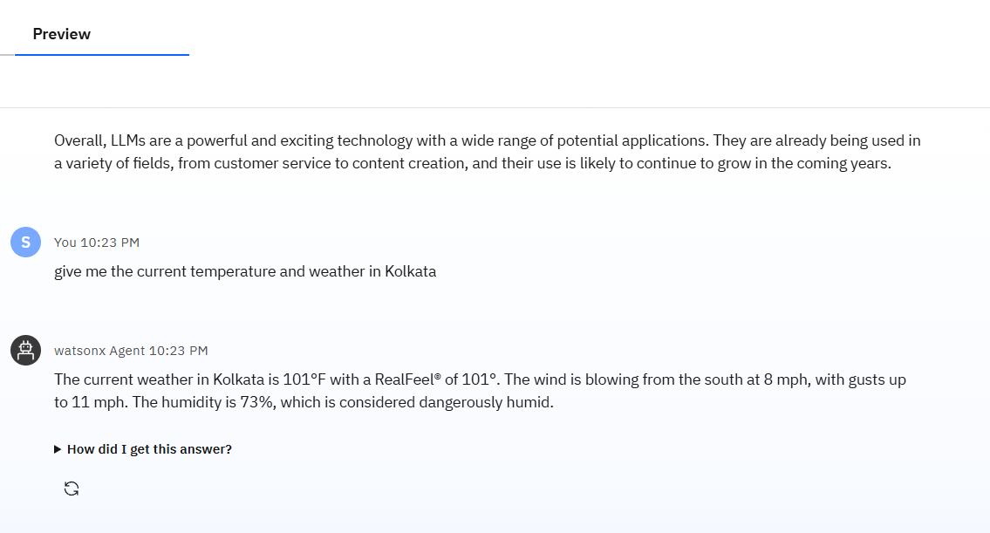
Results

Slide 11
Results

Slide 12
Conclusion
The Research AI Agent, deployed on IBM Cloud with watsonx.ai and the Granite model, streamlines literature search, summarization, and citation management. It identifies research gaps, drafts paper sections, and automates repetitive tasks, enabling researchers to focus on innovation. By enhancing efficiency, accuracy, and knowledge discovery, it demonstrates the transformative potential of AI-driven research tools in academic and industrial R&D.

Slide 13
Future scope
Multilingual research support.
Voice-activated research assistant.
Real-time collaboration features.
Integration with publishing platforms.
AI-assisted paper drafting.

Slide 14
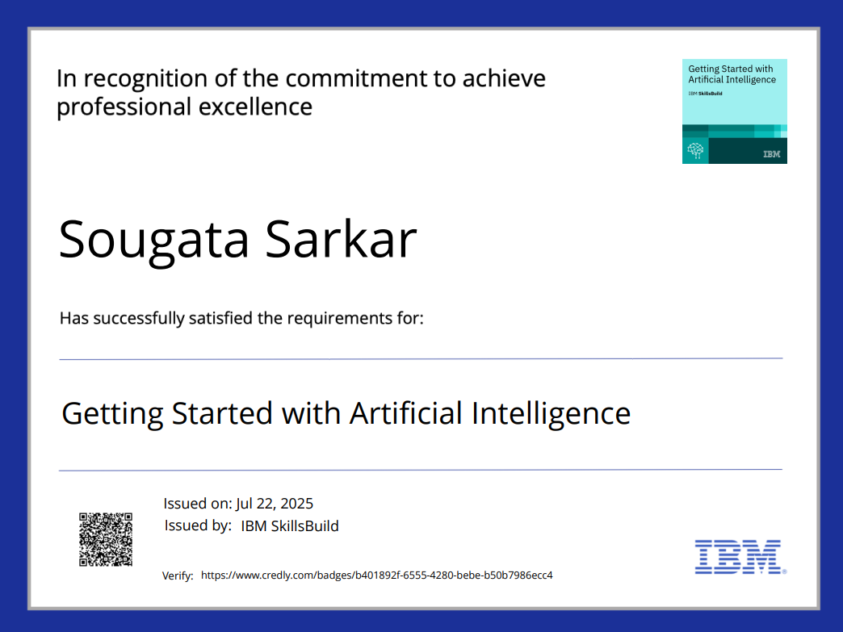
IBM Certifications

Slide 15
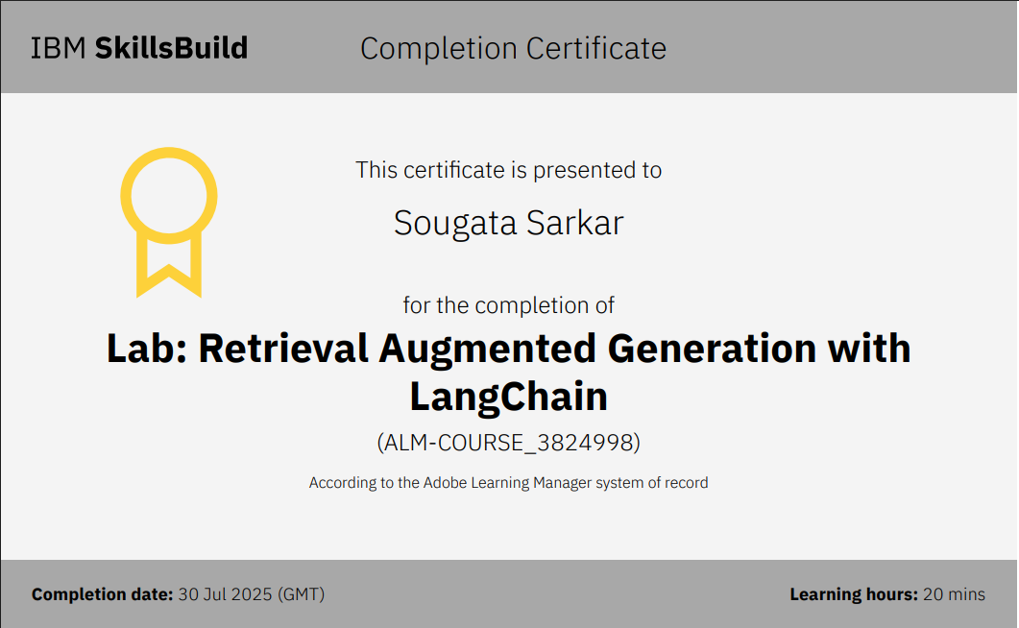

Slide 16
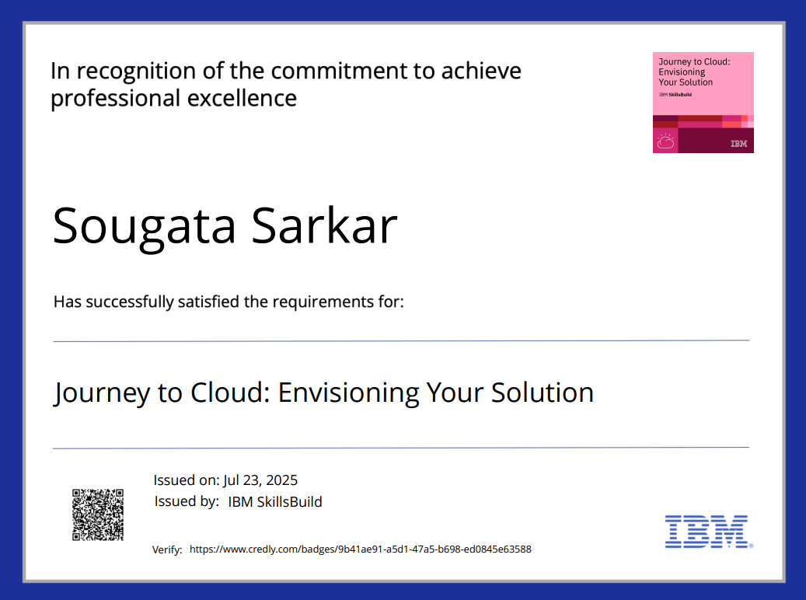

Slide 17
GitHub Link
https://github.com/sougata-sarkar-dev/research-agent.git

Slide 18
THANK YOU

